Slide 1
Operating system
Part X: File System (Interface & Implementation)
By KONG LingBo (孔令波)

Slide 2
Goals
Know the basic concepts related to file system
File, directory,
Know the implementation techniques
File organization
Directory implementation
Samples of File systems
NFS, NTFS …

Slide 3
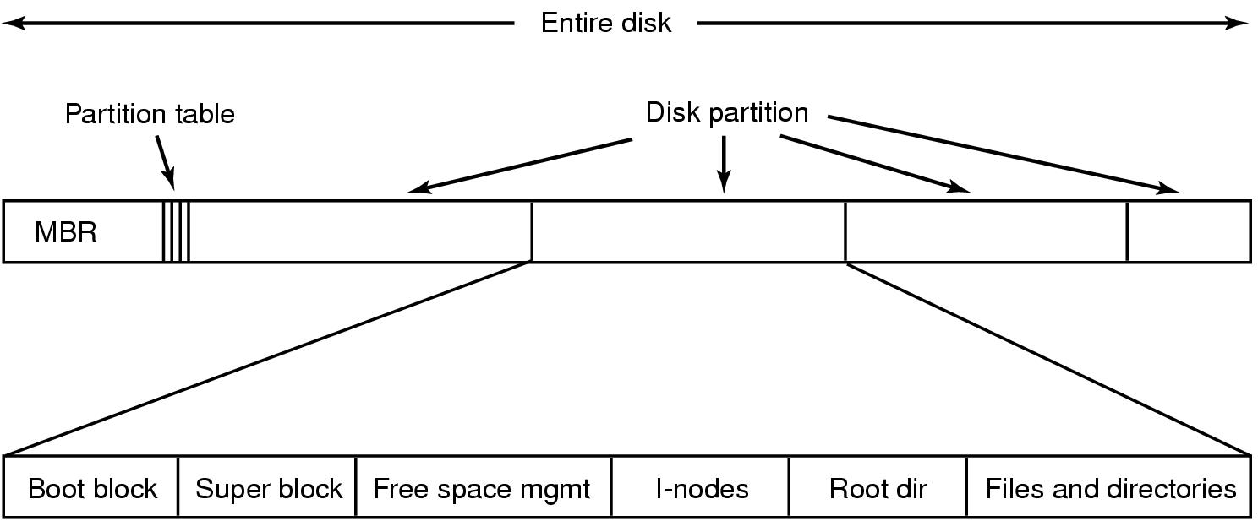
We’ve learned - Disk Space Organization
Disk can be partitioned
Each partition can have a different OS and/or different file system
One partition can be swap space for main memory
Each partition has
MBR style is the traditional way to partition the disk. You can browse GUID style in the Internet.
Block 0
Block 1
Block 2
Block K

Slide 4


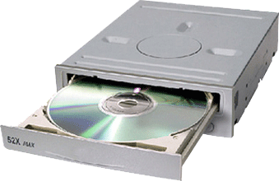
We’ve known - linear addressed block space for files
Processes
User’s (process’s) view of files
?
File System Calls
File 1
File 2
Manage files based on blocks? – Need data structures
0
1
2
3
4
5
file system’s view of the disk
Disk Driver
Disk Controller
Cylinders,
Header/tracks,
Sectors
0
1
2
3
4
5
Sector space
(like storage
units in MM)
Disk
6
7
8
9
10
11
Notes:
[2012-10-26]给研究生讲到这里的时候, 理得更顺了:
文件到硬盘空间的映射有两个子映射: File space → addressed Blocks, 和 Block → addressed sectors. 他们就跟文件到内存的基于页面的映射相类似: 文件的一堆0或1, 按照一定的size分割成固定大小的block, 然后每一个block又分割成更小的sector. 他们的映射就是查找是否有可用的bock/sector存放而已 – 当然, 需要有数据结构支持
那些数据结构也跟内存管理类似: 显然要有整个空间的管理结构, 以及每个文件/block映射到(block空间)/(sector集合)的映射表.
那么剩下的就是: 那些数据结构以及相应操作都存在哪里? 操作系统将之分成了两步骤: 专门的文件系统对文件进行管理 – 它们的组织结构以及文件到Blocks的映射; 驱动程序保存了硬盘的Sector空间以及Block到sector 的映射表.
处理流程如下:
当创建一个新文件时, 意味着在文件系统维护的数据结构中添加一个文件实例(属性, 目录等)
当写入数据时,意味着修改的内容从内存的页面保存到相应的Sector集合, 并且每一个页面要保存时, 也就意味着对应的Block中的0/1写入实际的Sector集合. 分成两步:
查找文件系统维护的Block表, 按照给定数据寻求可用的Blocks, 也就意味着对应每一Block的Sector也确定了;
Block写入Sector, 即将Block中的0/1集合分割成固定大小的小段, 然后交由磁盘的驱动程序找到相应的Sector写入即可
其他的操作, 如修改, 删除, 可以类似理解.
从上述描述知, 硬盘就是一个小的“电脑系统”: 电子部件对应电脑的CPU – 能够理解和执行一套指令以控制读写和数据的传输; 而驱动程序的作用就是提供给文件系统接口: 驱动程序显然是程序的集合(类似操作系统), 接收传来的指令和数据(往往是一个或多个Block)将写入到相应的Sector.

Slide 5
File & Device Management
Application
Process
System Interface
File
Manager
Device-Independent
Device-Dependent
Hardware Interface
Command
Status
Data
Device Controller
PPTs from others\cms.dt.uh.edu\chap05.ppt

Slide 6
Problems?
Like Mapping 1, we need following information – data structures & Related Operations
Organize blocks into semantic regions
Boot block, superblock, directory
Free space
You need know where available blocks are.
Map a file (collection of bits) into blocks
Needed blocks, and how to indicate them?
How to organize so many files?
Directory

Slide 7
File System
Mapping 2: File to HDisk (Linear addressed block Space)
Organize blocks into semantic regions
Boot block, superblock, directory
Free space
You need know where available blocks are.
Map a file (collection of bits) into blocks
Needed blocks, and how to indicate them?
How to organize so many files?
Directory

Slide 8
Boot block (or sector)
Some old system uses only one sector
Like the MBR for the hard disk, each partition usually uses the 1st block for special usage, called “boot block”
to record some critical information of how those blocks are used, such as regions for
Free space, files, directory, …
If the partition contains OS, the boot block also records the information to locate the “bootstrap loader”

Slide 9
We have many partition layouts
MS-DOS layout
System disk contains boot block in first block of each partition
Boot block has bootstrap executable
Bootstrap loader copies bootstrap program into memory
Bootstrap program initializes all registers, finds OS kernel on disk, loads OS, and jumps to the initial address of OS
Sector number
0
Boot block
1
FAT
Root directory
Files
Free blocks
MS-DOS disk layout

Slide 10
Cont’
UNIX like
A possible file system layout with a Unix partition
Notes:
Boot block (loads OS in kernel space)
Superblock (contains key info about file system which is read into memory at boot time)
Free space management
List of i-nodes (or other data structure) giving info about all files
Directories and Files

Slide 11
File System
Mapping 2: File to HDisk (Linear addressed block Space)
Organize blocks into semantic regions
Boot block, superblock, directory
Free space
You need know where available blocks are.
Map a file (collection of bits) into blocks
Needed blocks, and how to indicate them?
How to organize so many files?
Directory

Slide 12
File System Implementation: Free Space Management
How can we keep track of free blocks of the disk?
Which blocks are free?
We need this info when we want to allocate a new block to a file.
Allocate a block that is free.
There are several methods to keep track of free blocks:
Bit vector (bitmap) method
Linked list method
Grouping
Counting

Slide 13
Free-Space Management: Bit Vector (Bit map: 位图)
We have a bit vector (bitmap) where we have one bit per block indicating if the block is used or free.
If the block is free the corresponding bit can be 1, else it can be 0 (or vice versa).
Example:
Disk Blocks
0
1
2
3
4
5
6
7
8
9
10
11
0000 1101 0110
BitMap
Used
1: free
0: used
free

Slide 14
Cont’
Bit vector (n blocks in disk)
0
1
2
n-1
…
0 ⇒ block[i] used
1 ⇒ block[i] free
bit[i] =
(or vice versa)
0000000000000000
0000000000000000
0000000000000000
0000000010000000
0000000000000000
0000000000011000
0001100010000000
0000000011110000
Finding a free block (i.e. its number)
Start searching from the beginning of the bitmap:
Search for the first 1
First Free Block Number =
(number of 0-value words) * (number of bits per word)
+ offset of first 1-valued-bit
3x16+8 = 56
Notes:
14

Slide 15
Simple check
If the block size is 4KB, and the hard disk size (or a partition) is 500 GB, how many blocks are used to store the bitmap?
1 GB = 2³⁰ B
You’ll meet this kind of questions all the time
How many blocks are used to store the needed information?
Do you know in HDD, GB means 10⁶ B?

Slide 16
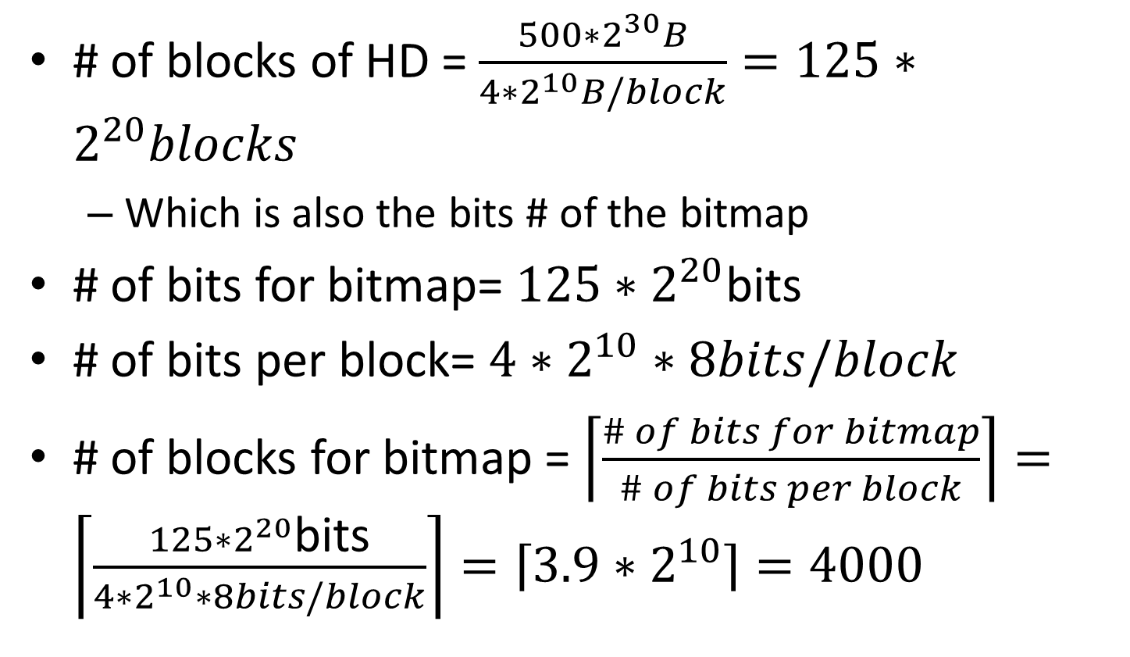
# of blocks of HD = $\frac{500∗2^{30}B}{4∗2^{10}B/block}=125∗2^{20}blocks$
Which is also the bits # of the bitmap
# of bits for bitmap= $125∗2^{20}$bits
# of bits per block= $4∗2^{10}∗8bits/block$
# of blocks for bitmap = $\left\lceil \frac{\# of bits for bitmap}{\# of bits per block}\right\rceil =\left\lceil \frac{125∗2^{20}\text{bits}}{4∗2^{10}∗8bits/block}\right\rceil =\left\lceil 3.9∗2^{10}\right\rceil =4000$

Slide 17
File System
Mapping 2: File to HDisk (Linear addressed block Space)
Organize blocks into semantic regions
Boot block, superblock, directory
Free space
You need know where available blocks are.
Map a file (collection of bits) into blocks
Needed blocks, and how to indicate them?
How to organize so many files?
Directory

Slide 18
File System Implementation: File Space Allocation
Goals
Fast sequential access
Fast random access
Ability to dynamically grow
Minimum fragmentation
Standard schemes
Contiguous allocation (fixed)
Linked list allocation
Linked list with file allocation table (FAT)
Linked list with Indexing (I-nodes)

Slide 19
Contiguous Allocation
Each file occupies a set of contiguous blocks on the disk
+ Simple – only starting location (block #) and length (number of blocks) are required to find out the disk data blocks of file
+ Random access is fast
- Wasteful of space (dynamic storage-allocation problem)
- Files cannot grow
file data
Start address = 6
Number of blocks = 4
disk blocks (physical blocks)
0
1
2
3
4
5
6
7
8
9
10
11
0
Notes:
19

Slide 20
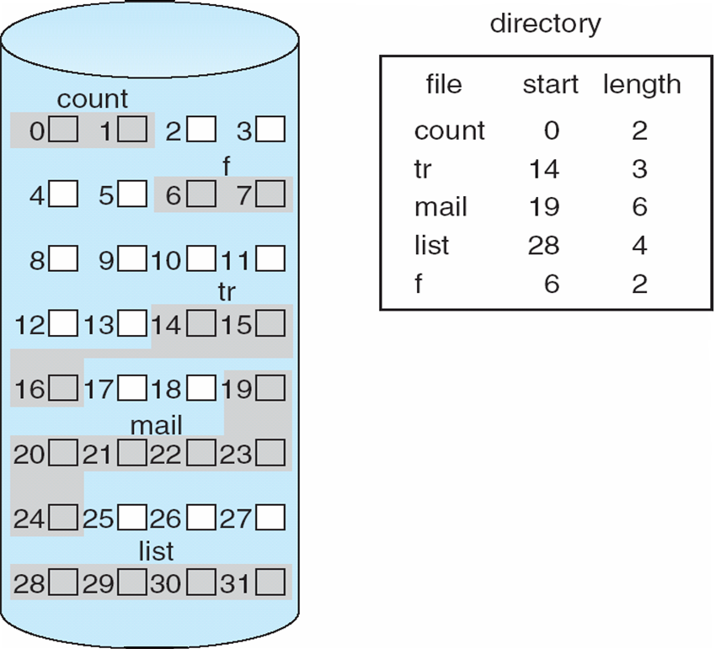
Contiguous Allocation of Disk Space
Notes:
20

Slide 21
Linked Allocation
Each file is a linked list of disk blocks: blocks may be scattered anywhere on the disk.
pointer
(to the next block allocated to the file X)
block structure
Pointer
data
DiskBlockSize
(power of 2)
DataSize
file data
File data size in a disk block is no longer a power of 2
Notes:
21

Slide 22
Linked Allocation (cont’)
File X
File starts at disk block 5
pointer
disk blocks (physical blocks)
0
1
2
3
4
5
6
7
8
9
10
11
8
3
10
data

Slide 23
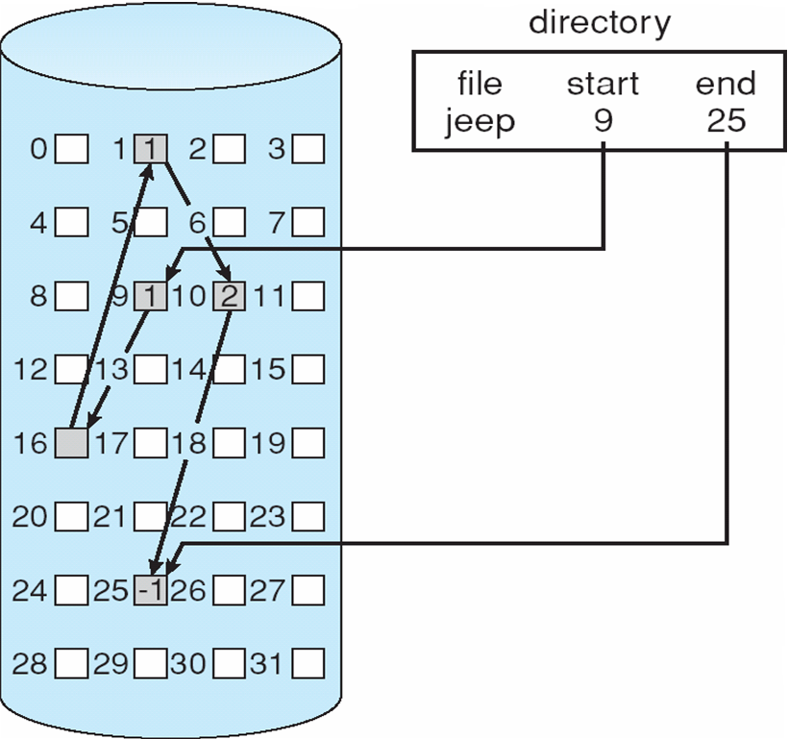
Linked Allocation
Notes:
23

Slide 24
Linked Allocation (cont.)
Just as those shortcomings of linked list you learned in DSA
Slow - defies principle of locality.
Need to read through linked list nodes sequentially to find the record of interest.
Not very reliable
System crashes can scramble files being updated.
Important variation on linked allocation method
File-allocation table (FAT) - disk-space allocation used by MS-DOS and OS/2.

Slide 25
File Allocation Table
The File Allocation Table (FAT) is a variation to the linked allocation method used to support direct access
disk-space allocation used by MS-DOS and OS/2.
The FAT file system is a simple file system originally designed for small disks and simple folder structures.
named for its method of organization, the file allocation table, which resides at the beginning of the volume.
To protect the volume, two copies of the table are kept, in case one becomes damaged.
In addition, the file allocation tables and the root folder must be stored in a fixed location so that the files needed to start the system can be correctly located

Slide 26
File Allocation Table
The File Allocation Table (FAT) has many versions: FAT12, 16, 32 …
FAT12 is only seen on floppy disks and very small storage media, while FAT16 is the older version of FAT from the Windows 95 days, and FAT32 is newer, from the Windows 98 days.
NT, 2000, XP, Vista, and Windows 7 can use all the FAT file systems, plus the NTFS (New Technology File System)

Slide 27
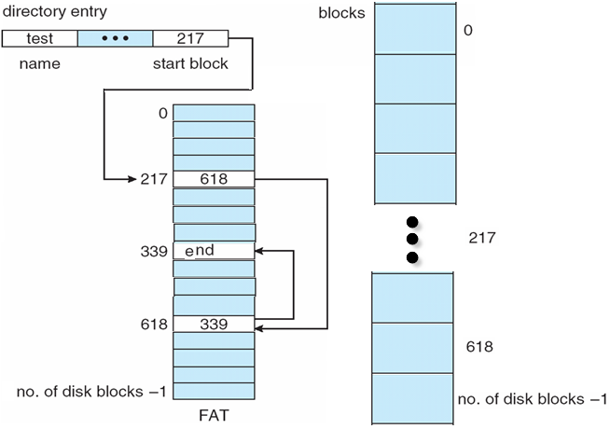
Cont’
Pointers are kept in a table (FAT)
Data Block does not hold a pointer; hence data size in a block is a power of 2.
Directories can also be represented using FAT
Notes:
Directories can also be represented using FAT: just store the necessary information of files in one directory.

Slide 28
Cont’
Free blocks
A directory file
Notes:
Directories can also be represented using FAT: just store the necessary information of files in one directory.

Slide 29
Cont’
Of course the FAT is also stored in blocks
So the size limit of a file is determined by
number of FAT entries
Size of block
Given:
Block size = 4096 bytes
Length of a entry in FAT = 8 bytes
➔ one block can contain 4096/8 = 512 entries
So the size of a file by using only one block could be: 512* 4KB = 2048KB = 2GB

Slide 30
Questions
A hard disk has 40G, its each block size is 1K，and each table entry of FAT needs 20 bits，then Its FAT (File Allocation Table) need （ ）memory space A）100M B）120M C）140M D）160M
Notes:
How many blocks ? – 40G/1K = 40*2²⁰
Each entry needs 20bits – 3B
Each block could contain how many entries? – 1KB/3B
We have 40*2²⁰/ (1KB/3B) = 120 MB

Slide 31
Indexed Allocation
Brings all pointers together into the index block.
Logical view
Index table

Slide 32
Indexed Allocation – Mapping (Cont.)
Two-level index
inner index table
Data
block
….
pointer to
outer index table
(keep in FCB for the file)
Data
block
inner index table

We can also compute the size limit of a file following the idea introduced in FAT. Attention to the levels ☺
….
Data
block
inner index table
….
outer-index
index table
file
Notes:
32

Slide 33
Indexed Allocation - Mapping
Mapping from logical to physical in a file of unbounded length.
Linked scheme -
Link blocks of index tables (no limit on size)
Multilevel Index
E.g. Two Level Index - first level index block points to a set of second level index blocks, which in turn point to file blocks.
Increase number of levels based on maximum file size desired.
Maximum size of file is bounded.

Slide 34
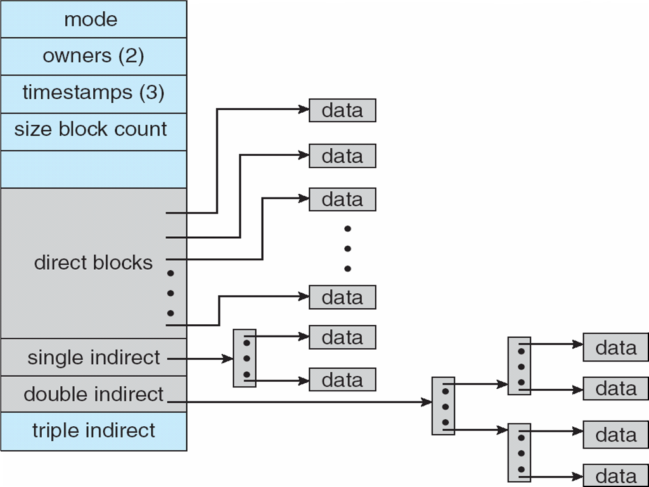
Combined Scheme: UNIX (4K bytes per block)
FCB – in Unix this is called i-Node

Slide 35
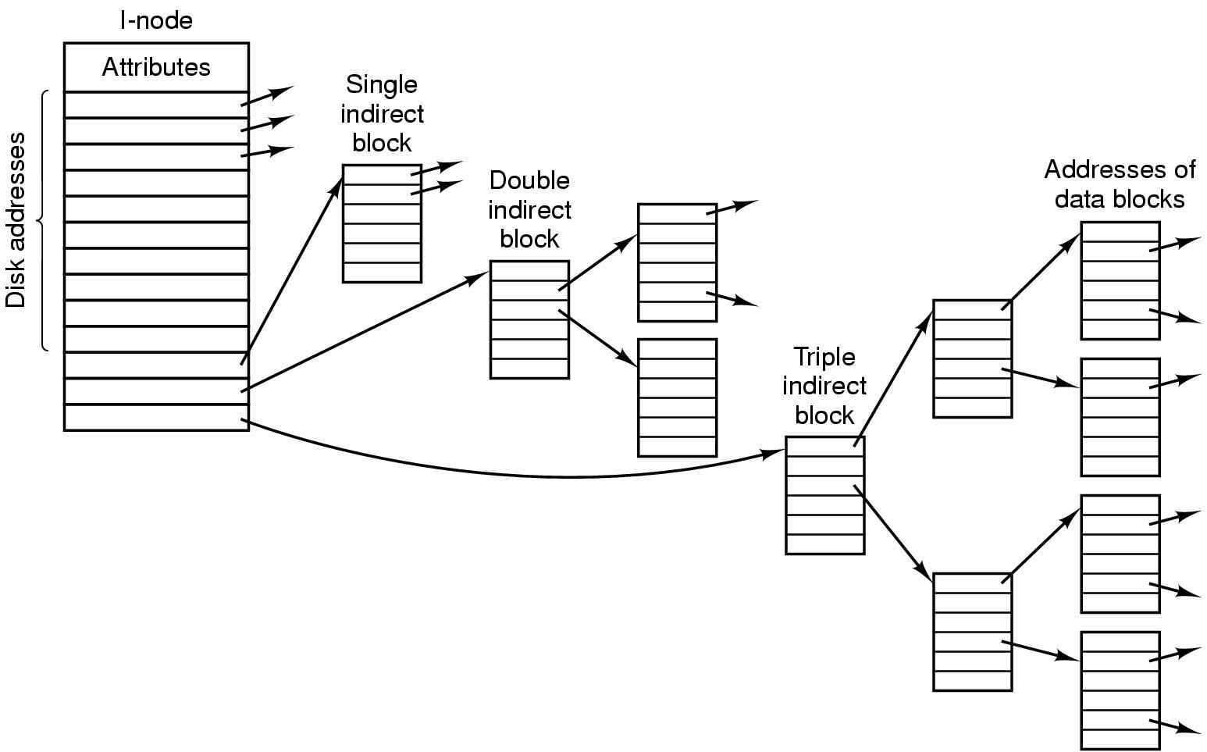
Unix i-node
Part XI: File System
35

Slide 36
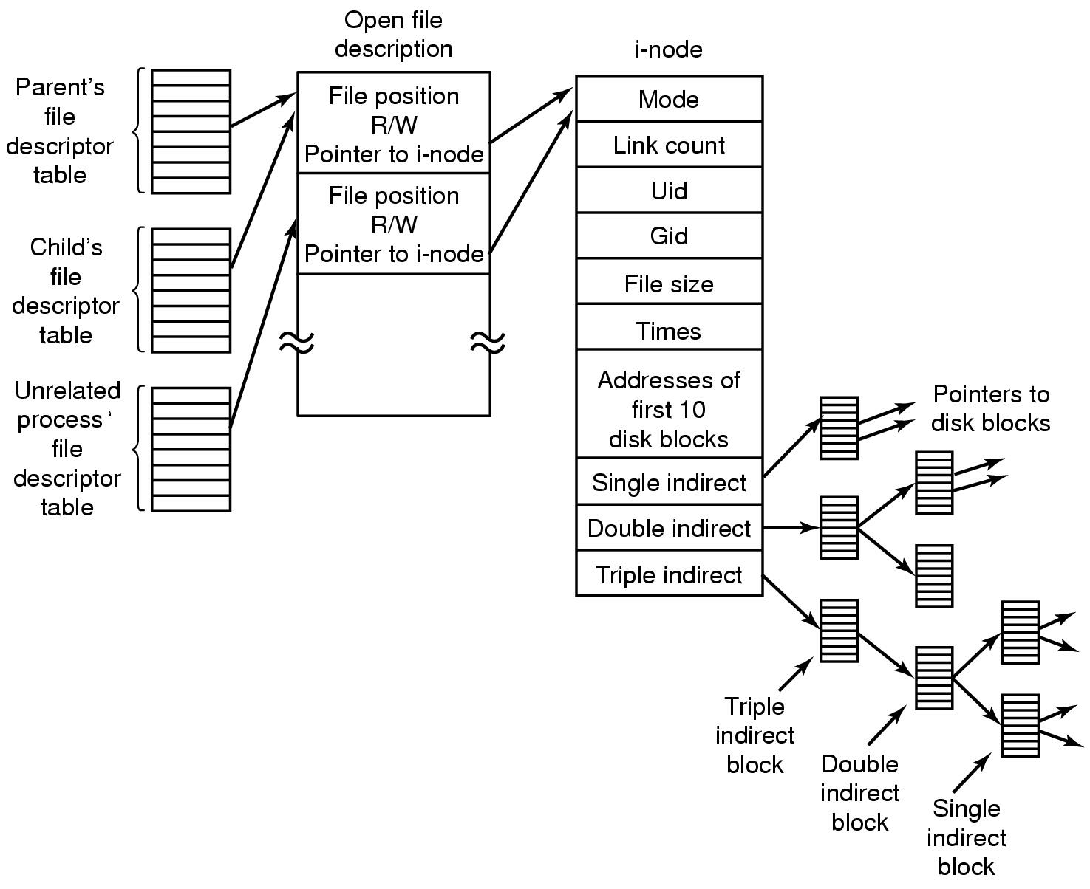
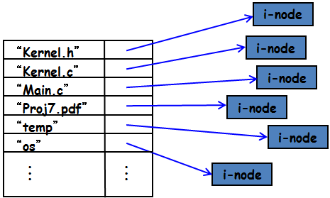
The UNIX I-node
PPTs.2013-64\PPTs from other\web.cecs.pdx.edu_~walpole_class_cs533_winter2005_slides\2013 Winter Introduction to Operating Systems\17.ppt

Slide 37
Assume that the index-node of a file has 7 pointers, among which 4 are for data blocks, 2 pointers for “indirect block”, and 1 pointer for “doubly indirect block”.
The size of both data block and index block are 256KB. The length of a pointer is 4 Bytes.
What is the max file size this file system can support?

Slide 38
Entry Lookup
In Unix systems
The superblock (among other things) has the location of the i-node which represents the root directory
Once the root directory is located a search through the directory tree finds the desired directory entry
The directory entry provides the information needed to find the disk blocks for the requested file

Slide 39
Entry Lookup
This discussion focuses on Unix-related file systems
When a file is opened, the file system must take the file name supplied and locate its disk blocks
Let’s see how this is done for the path name /usr/ast/mbox

Slide 40
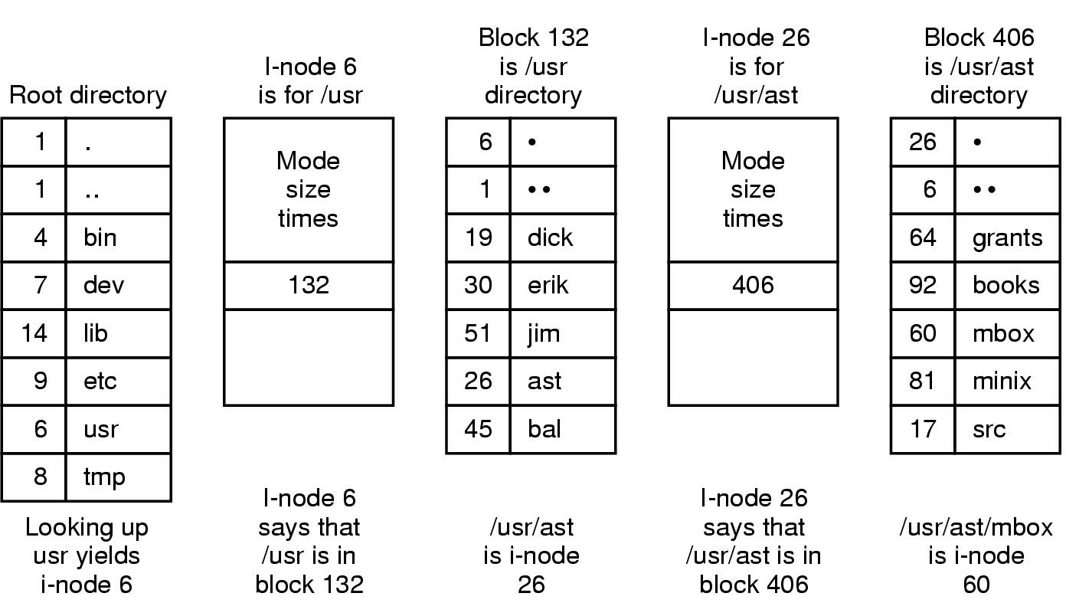
Looking up for an entry
The steps in looking up /usr/ast/mbox
Notes:
A data block for a directory consists of entries where an entry consists of the i-block and the file name.
i-nodes are uniquely identified

Slide 41
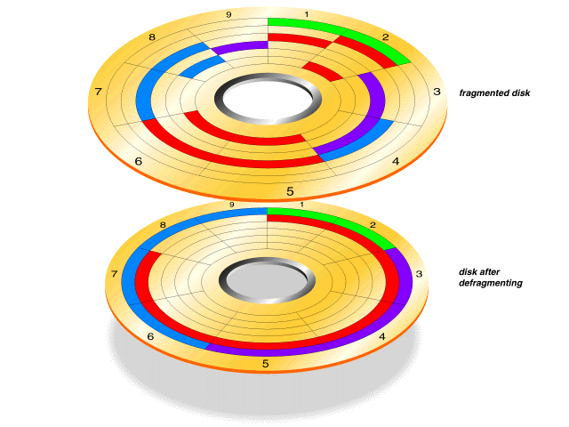
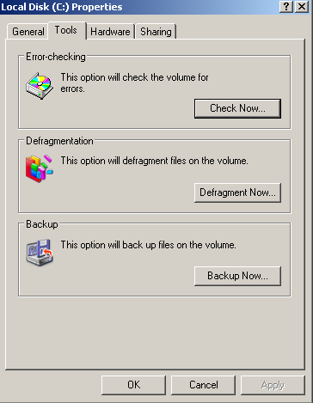
Fragmentation and Defragmenting for disks
PPTs\Part XII\Part XII magnetic media].ppt

Slide 42
File System
Mapping 2: File to HDisk (Linear addressed block Space)
Organize blocks into semantic regions
Boot block, superblock, directory
Free space
You need know where available blocks are.
Map a file (collection of bits) into blocks
Needed blocks, and how to indicate them?
How to organize so many files?
Directory

Slide 43
Files and Directories
There are two basic things that are stored on disk as part of the area controlled by the file system
- files (store content)
- directory information (can be a tree): keeps info about files, their attributes or locations
Disk
Directory
attrs
file
attrs
file
filename
filename
filename
attrs
File (content)

Slide 44
Directory Implementation: directory entries
games
attributes
games
mail
attributes
mail
news
attributes
news
work
attributes
work
a directory with fixed sized entries
attributes include location
info for data blocks of the file
FCB containing attributes
Using fixed sized names

Slide 45
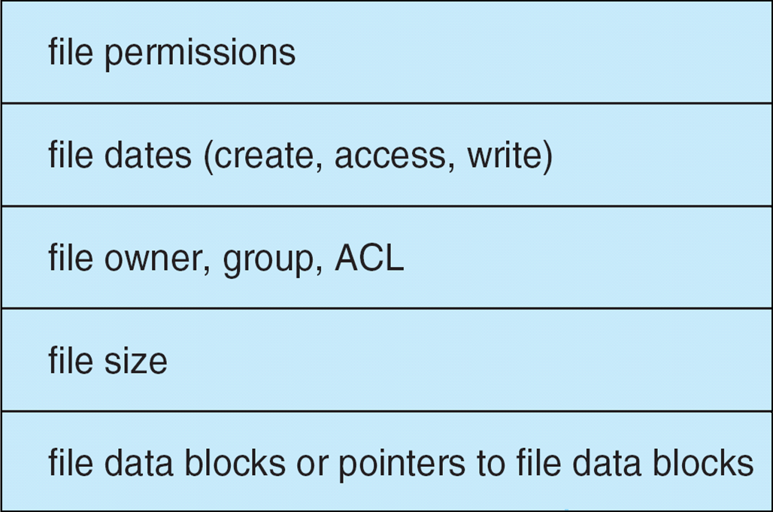
A Typical File Control Block
Filename=X
info about locating the FCB
directory entry
File Control Block of a file with filename X
File Data Blocks of X
Tom
John
Jane
Jonas
Kong
Mary

Slide 46
Cont’
Linear list of file names with pointers to the data blocks
simple to program
time-consuming to execute - linear search to find entry.
Sorted list helps - allows binary search and decreases search time.
Hash Table - linear list with hash data structure
decreases directory search time
collisions - situations where two file names hash to the same location.
Each hash entry can be a linked list - resolve collisions by adding new entry to linked list.

Slide 47
Of course, you should provide File Operations
File is an abstract data type
Common Operations that are supported by the Operating System:
Create
Write
Read
Reposition within file
Delete
Truncate
Open(F_{i}) – search the directory structure on disk for entry F_{i}, and move the content of entry to memory
Close (F_{i}) – move the content of entry F_{i} in memory to directory structure on disk

Slide 48
File System Implementation: Directory Implementation
A directory entry provides the info needed to find the disk data blocks of a file
disk address of first block and size
address of first block
number of associated i-node
File attributes can be stored in the directory entry (Windows) or in its i-node (Unix)
File name and support of variable length and long file names (255 chars)

Slide 49
Directory Structure
A collection of nodes containing information about all files
Directory
filename
Files
file content (data)
F 1
F 2
F 3
F 4
F n
Both the directory structure and the files reside on disk
Backups of these two structures could be kept on tapes

Slide 50
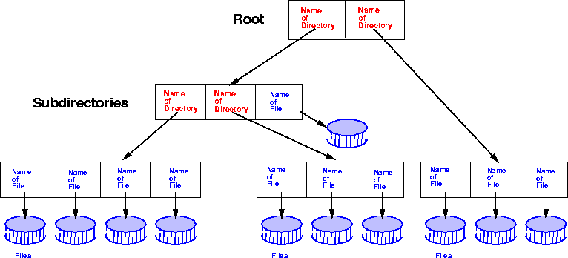
Directory Structure: Tree structured Directories

Slide 51
Cont’
Absolute or relative path name
Absolute from root
Relative paths from current working directory pointer.
Creating a new file is done in current directory
Creating a new subdirectory is done in current directory, e.g. mkdir <dir-name>
Delete a file , e.g. rm file-name
Deletion of directory
Option 1 : Only delete if directory is empty
Option 2: delete all files and subdirectories under directory

Slide 52
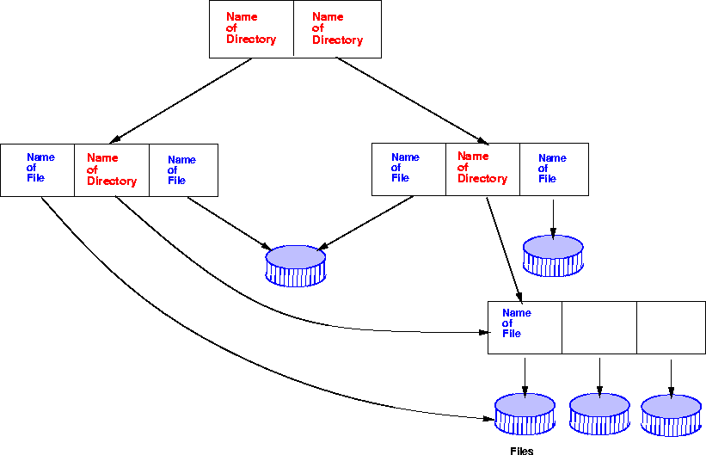
Directory Structure: Acyclic Graph Directories [无环图目录]
Given this structure, do you have any idea to represent the corresponding data structure?

Slide 53
Cont’
Acyclic graphs allow sharing
Implementation by links
Links are pointers to other files or subdirectories
Symbolic links or relative path name
Directory entry is marked as a link and name of real file/directory is given. Need to resolve link to locate file.
Implementation by shared files
Duplicate information in sharing directories
Original and copy indistinguishable.
Need to maintain consistency if one of them is modified.

Slide 54

In summary

Slide 55
File system [文件系统]
The collection of algorithms and data structures which perform the translation from logical file operations (system calls) to actual physical storage of information
Provide storage of data and manipulation
Guarantee consistency of data and minimize errors
Optimize performance (system and user)
Eliminate data loss (data destruction)
Support variety of I/O devices
Provide a standard user interface
Support multiple users
PPTs from others\www.ceng.metu.edu.tr_courses_ceng334\Ch_4_FS.ppt

Slide 56
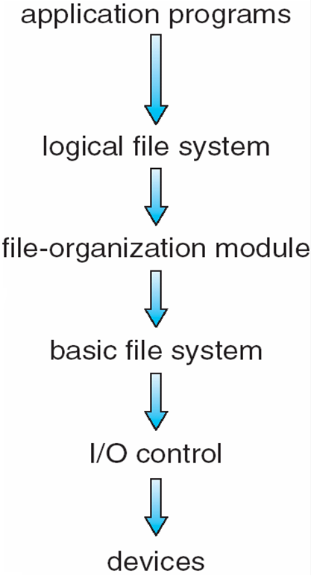
File System
The file system should provide an efficient implementation of the interface
storing, locating, retrieving data
The problem: define data structures and algorithms to map the logical File System onto the disk
some data structures live on disk
some data structures live (temporarily) in memory
Typical layer organization:
Good for modularity and code re-use
Bad for overhead
PPTs from others\navet.ics.hawaii.edu_~casanova_courses_ics412_fall09\ics412_fs2.ppt

Slide 57
Layered Software
Processes
read file f, write file f, ..
(operation will be offset p, n bytes)
File System Calls
File System
find file info for f
(f, p, n) → disk block numbers
Kernel
Mode
Software
write disk block x, ..
read disk block x, …
Disk Driver
[cylinder#, track#, sector#],
operation code: R,W
Disk Controller
Hardware
Disk
cylinders, tracks, sectors
Notes:
Zh 4-28

Slide 58
File System Implementation
Major On-disk Structures (information):
Boot control block contains info needed by system to boot OS from that volume
Volume control block contains volume details
Directory structure organizes the files
Per-file File Control Block (FCB) contains many details about the file
info about a file and its location on disk
partition (volume) starts
Pointers to FCBs
Boot
Control
Block
Volume
Control
Block
Directory
Structure
File Control Blocks
(FCBs)
(filename to FCB mapping)
(i.e. superblock)

Slide 59
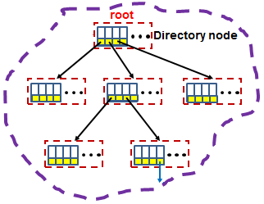
0000 1101 0110
Bitmap
Blocks for files
and directories
Disk → Partitions → Blocks → FS

Slide 60
File space
A Directory → Files
Header
(pointer)
column
game
mail
news
work
File Control Block of a file with filename X
Tom
John
Jane
Jonas
Kong
Mary

Slide 61
C:
C:\lbkong\thesis\students.doc
Directory node
Tree structure of
directories
lbkong
FCB of “students.doc”
thesis
With your DSA experience, you should consider the related operations on this data structure. Could you imagine how to locate “students.doc”? And other file operations??
Tom
John
Jane
Jonas
Kong
Mary
File space: collection of blocks used to store the data of the file

Slide 62
Compared with MM
To run our program, the needed pages should be fetched into MM
(PCB maintains the reference for our program file)
(OS maintains the mapping info between program pages and blocks)
Our program exists first as file
which may contain many pages
(filename → FCB → Efficient data structure (like Hash, i-node,…)→Blocks)
Addressed frame/page space
(usually 4KB)
Addressed block space
(usually 4KB)
Addressed Storage unit space
(1 byte)
Addressed Sector space
(512 bytes)

Slide 63
Suggest for deeper study
You can try to implement a simulation program to support file + directory
Data structure + Operators
New file, Delete, Rename, …
Continue to consider how to support concurrent access of a file by many user?
What should we consider ? – Data structure + Operators
Have you ever considered how to store an array of structs into a file? – Don’t forget to reconstruct their structure when reading into MM
This is quite helpful for your understanding DBMS
Helpful for your understanding about the implementation of DBMS

